Slide 1
Implementing Historical Algorithms
Jeffrey M. Binder
Pennsylvania State University
@JeffMBinder
jeffreymbinder.net

Slide 2
Algorithms Avant la Lettre

Slide 3
Algorithms Avant la Lettre

Slide 4
Algorithms Avant la Lettre
There hath been much time and diligence bestowed by Industrious and Learned Men of Communicative Spirits of former Ages, and of late Times, to reduce their Arithmetical Theories into Practice, to fit their Conclusions to Instrumental work, for the benefit of Illiterate Artificers: As so successful have their endeavors prov’d, that thereby Commodious Advantages have arrived to Persons of divers Faculties, who though they have been altogether ignorant of Arithmetick, and of all Literature, yet by the benefit of Instrumental Operation, they have been capacitated to perform such Conclusions, as their respective Faculties required, though thereof they have not been able to give a better Reason, than that it is so, because it is so.
John Peter, Artificial Versifying (revised ed.)

Slide 5
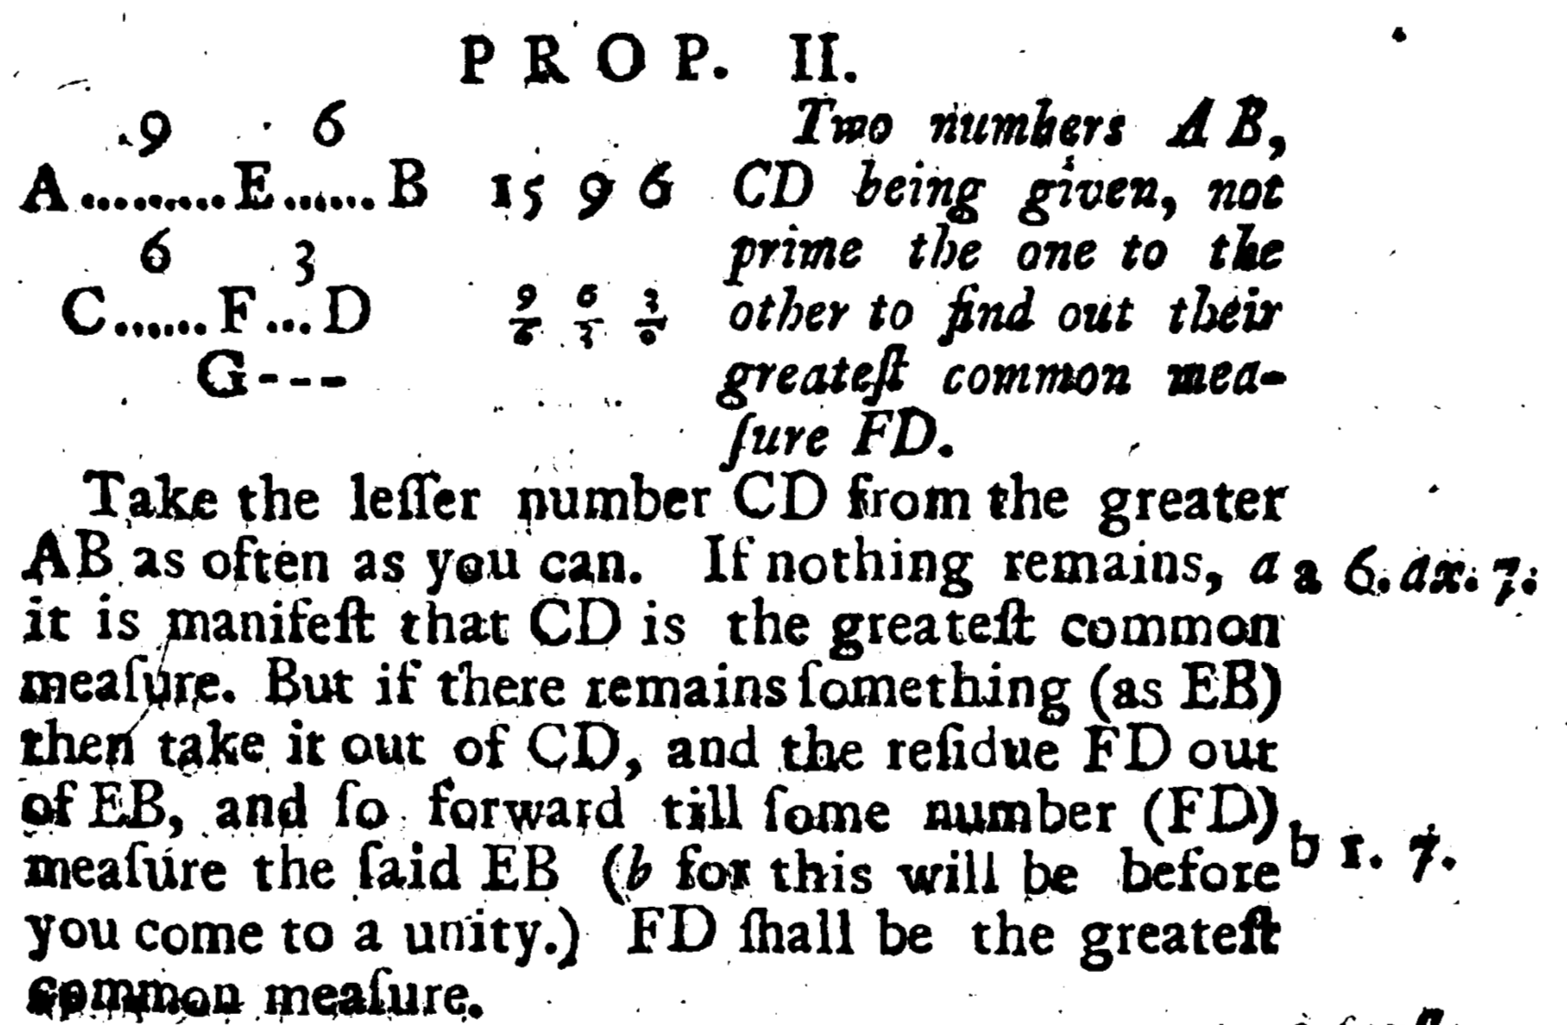
How Far Back?
From Isaac Barrow’s translation of Euclid’s Elements (1714 ed.)

Slide 6
From Algorism to Algorithms

Slide 7
From Algorism to Algorithms
When you wish to add a number to a number or to subtract a number from a number, place both numbers in two rows, one of them, that is, below the other, and let the place of the units (sc. in one number) be beneath the place of the units (sc. in the other) and the place of the tens beneath the place of the tens. But if you wish to aggregate the two numbers, i.e., to add one to the other, you will add each place to the place that is above it with regard to its own kind, i.e., units to units and tens to tens. When ten has been collected in one of the places, i.e., in the place of the units or tens or in some other place, put a one instead of it and elevate it to a higher place, i.e., if you have ten in the first place which is the place of the units, make a one of it and raise it to the place of the tens and there it will signify ten. But if there remains something from the number that is less than X or the number itself is less than X, leave it in the same place. And if nothing remains, put a circle (i.e., o), so that the place may not be empty; but let there be a circle in it that occupies it, lest perchance, since it is empty, the places may be decreased and it may be thought that the second is the first, and so you will be misled in your number. Do likewise also in all the places. Likewise, when X has been collected in the second place, make a one from it and raise it to the third place; and there it will signify one hundred and whatever is left over below X will remain there (i.e., in the second place). But if nothing remains in the other places, you will put a circle there as above. Do likewise in the rest of the places if there is more.
From “Dixit Algorizmi”—the medieval Latin manuscript that gives us the word algorithm
Derived from a lost Arabic text by Muḥammad ibn Mūsā al-Khwārizmī
English translation by John N. Crossley and Alan S. Henry

Slide 8
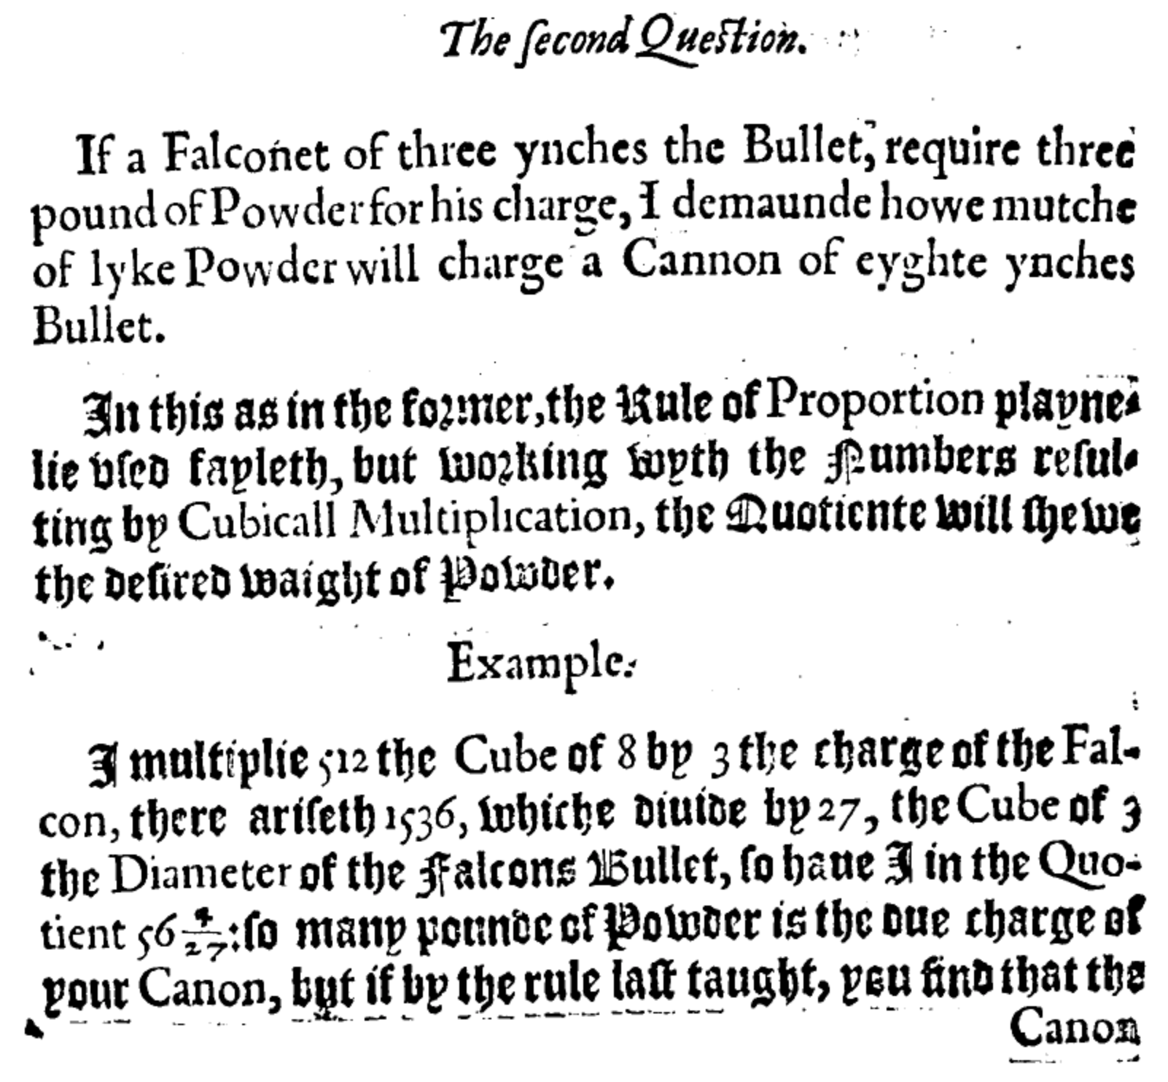
From Algorism to Algorithms
From An arithmeticall militare treatise named Stratioticos (1579)

Slide 9
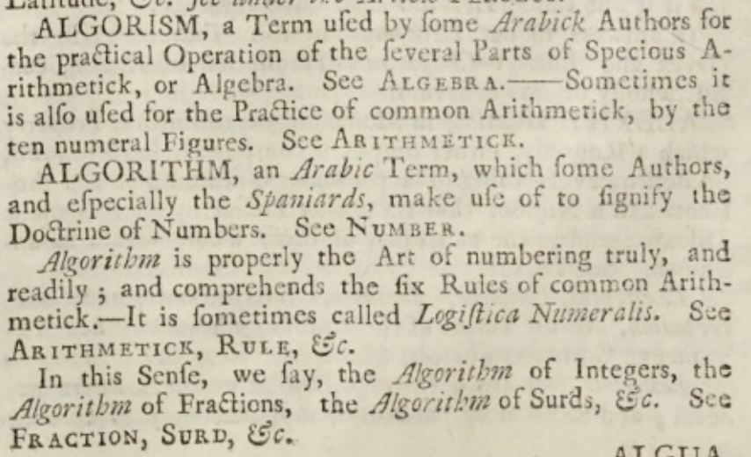
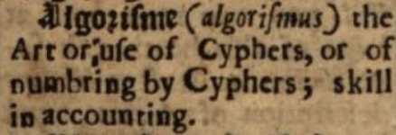
From Algorism to Algorithms
Thomas Blount, Glossographia (1656)
Ephraim Chambers, Cyclopaedia (1728)

Slide 10
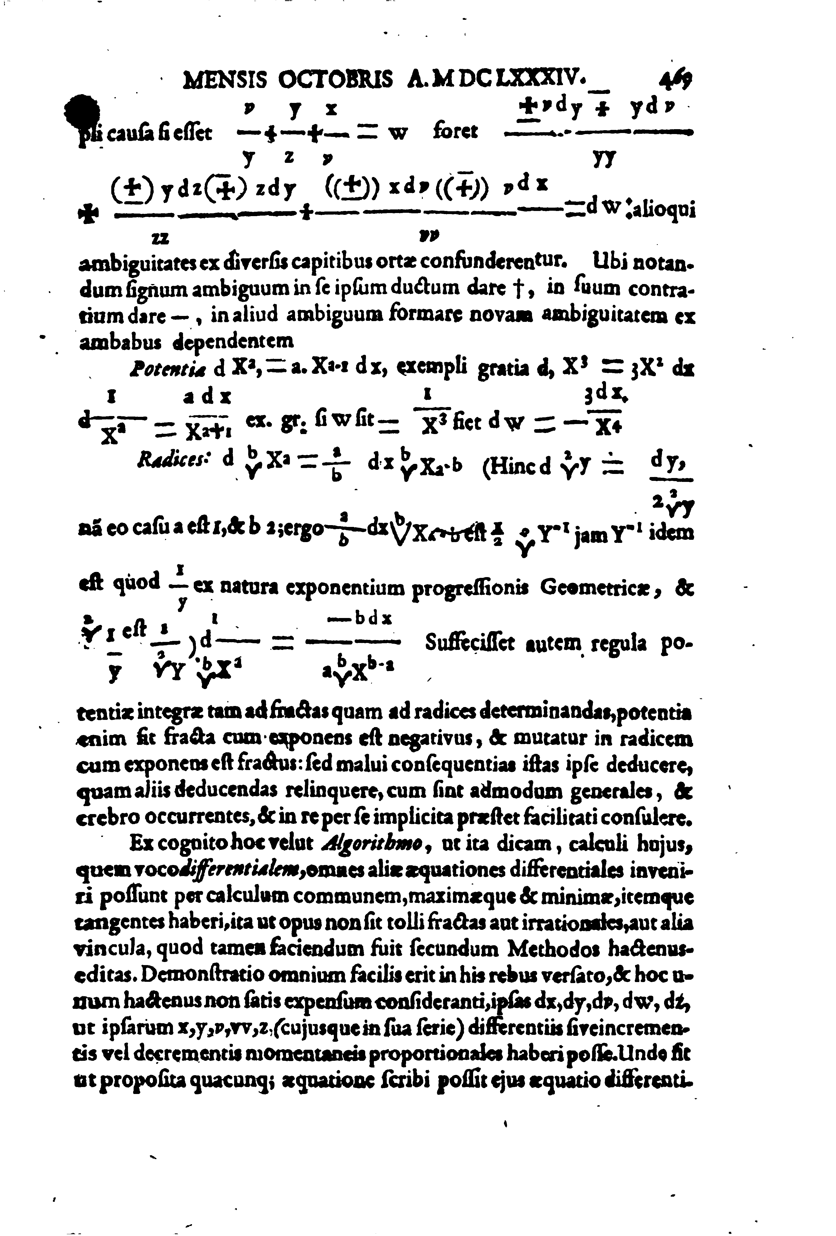
From Algorism to Algorithms
G. W. Leibniz, “Nova Methodus pro Maximis et Minimis” in Acta Eruditorum (1684)

Slide 11
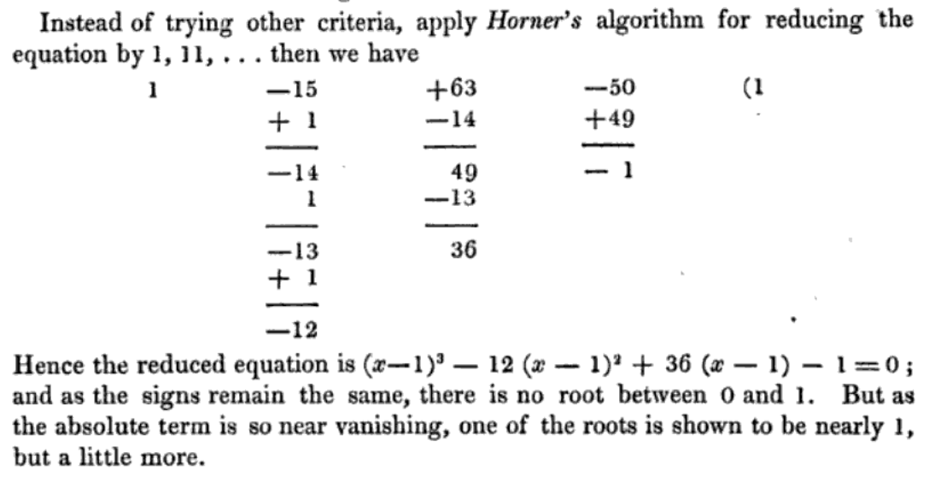
From Algorism to Algorithms
Charles Hutton, A Course of Mathematics (1836 ed.)

Slide 12
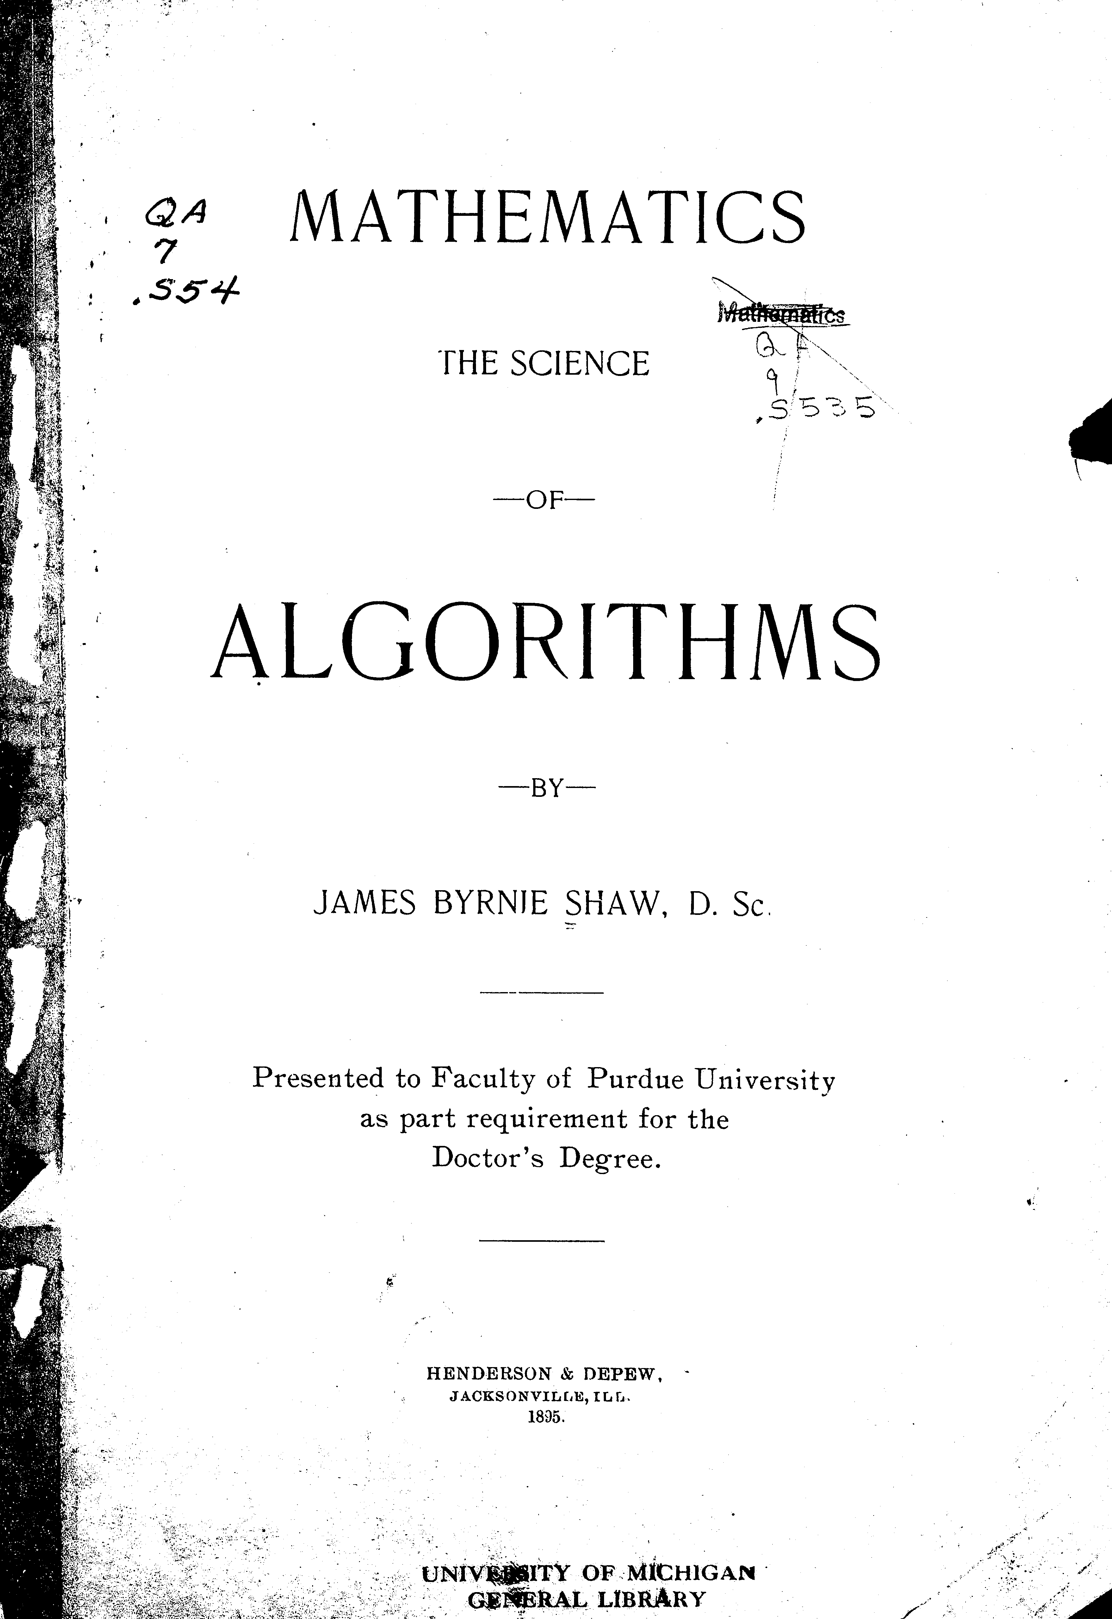
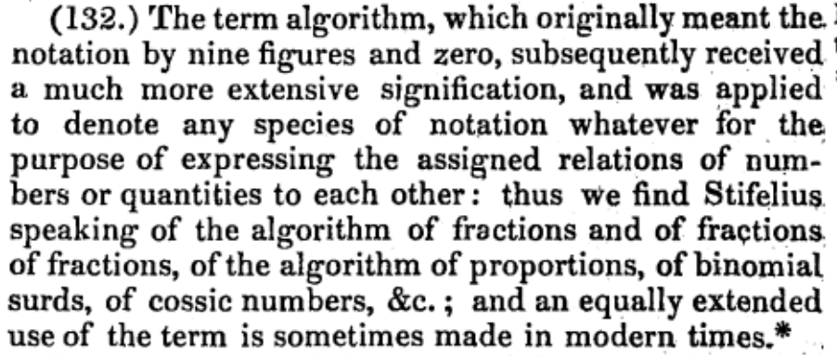
From Algorism to Algorithms
From Encyclopaedia Metropolitana (1845)

Slide 13
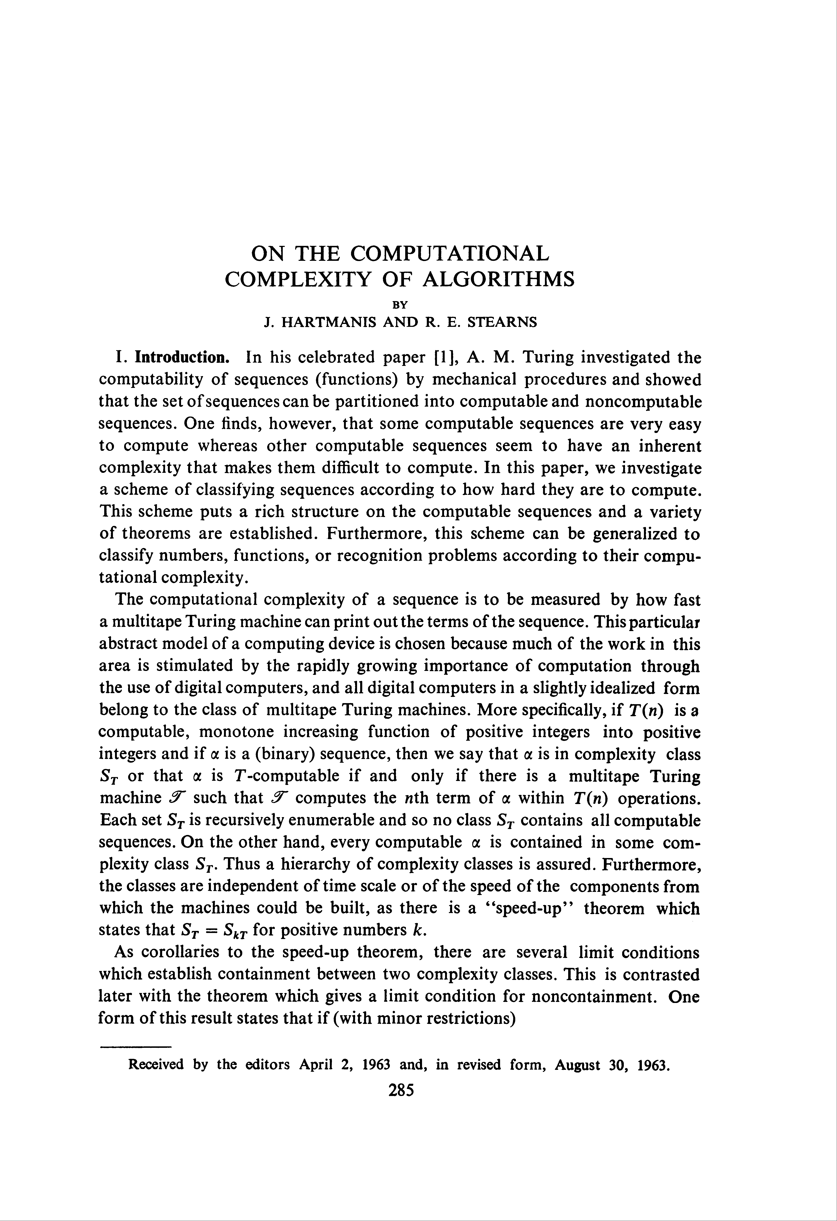
From Algorism to Algorithms

Slide 14
From Algorism to Algorithms

Slide 15
Implementation or Simulation?
def versify(digits, tables):
word_list = []
for i, digit in enumerate(digits):
table = tables[i+1]
word = ""
start_digit = 8 - int(digit)
if start_digit < 0:
start_digit += 9
for j in range(start_digit, len(table), 9):
letter = table[j]
if letter == " ":
break
word += letter;
word_list.append(word)
return ' '.join(word_list)

Slide 16
Implementation or Simulation?

Slide 17
How Far do we Go?
Benjamin Franklin, Autobiography:
About this time I met with an odd volume of the Spectator. […] I thought the writing excellent, and wished, if possible, to imitate it. With this view I took some of the papers, and, making short hints of the sentiment in each sentence, laid them by a few days, and then, without looking at the book, try'd to compleat the papers again, by expressing each hinted sentiment at length, and as fully as it had been expressed before, in any suitable words that should come to hand. […] I also sometimes jumbled my collections of hints into confusion, and after some weeks endeavored to reduce them into the best order, before I began to form the full sentences and compleat the paper. This was to teach me method in the arrangement of thoughts.

Slide 18
Implementing Franklin’s Procedure
The Mind that lies fallow but a single Day…
…Vice and Folly, into which the Age is fallen.
<START>The Mind that lies fallow but a single Da…
Code at github.com/jeffbinder/sentence-level-markov

Slide 19
Implementing Franklin’s Procedure
Melville:
WHAT the white whale was to Ahab, has been hinted; what, at times, he was to me, as yet remains unsaid.
Aside from those more obvious considerations touching Moby Dick, which could not but occasionally awaken in any man's soul some alarm, there was another thought, or rather vague, nameless horror concerning him, which at times by its intensity completely overpowered all the rest; and yet so mystical and well nigh ineffable was it, that I almost despair of putting it in a comprehensible form. It was the whiteness of the whale that above all things appalled me. But how can I hope to explain myself here; and yet, in some dim, random way, explain myself I must, else all these chapters might be naught.
Reconstructed by Franklin Bot:
What the white whale was to Ahab, has been hinted; what, at times, he was to me, as yet remains unsaid.
Bethink thee of the albatross, whence come those clouds of spiritual wonderment and pale dread, in which that white phantom sails in all imaginations? Wonder ye then at the fiery hunt? To analyse it, would seem impossible. The flashing cascade of his mane, the curving comet of his tail, invested him with housings more resplendent than gold and silver-beaters could have furnished him. He was the elected Xerxes of vast herds of wild horses, whose pastures in those days were only fenced by the Rocky Mountains and the Alleghanies.

Slide 20
A Medieval Procedure
When ø is equal to ϑ and ʒ, ø and ϑ must be divided by ʒ, ϑ halved, the half drawn into itself, the product added to the number. The radix of the aggregated whole minus half ϑ reveals what is sought.
From Robert of Chester’s c. 1145 Latin version of Al-ğabr (my translation into English)

Slide 21
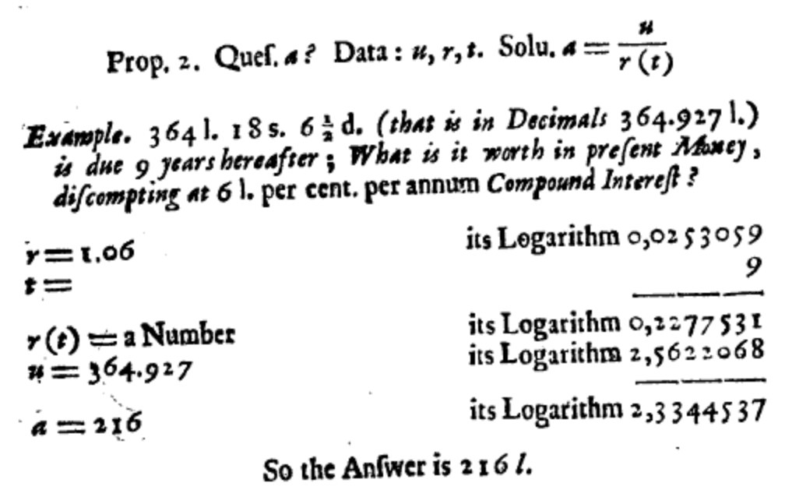
A Somewhat More Modern Example
From Michael Dary’s Interest Epitomized, Both Compound and Simple (1677)

Slide 22
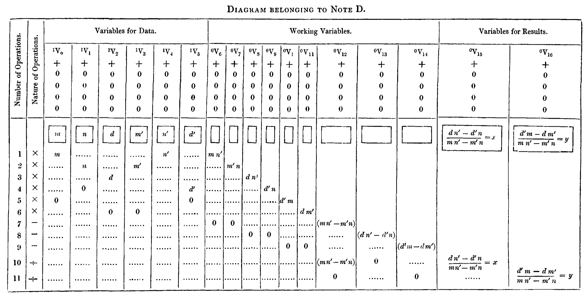
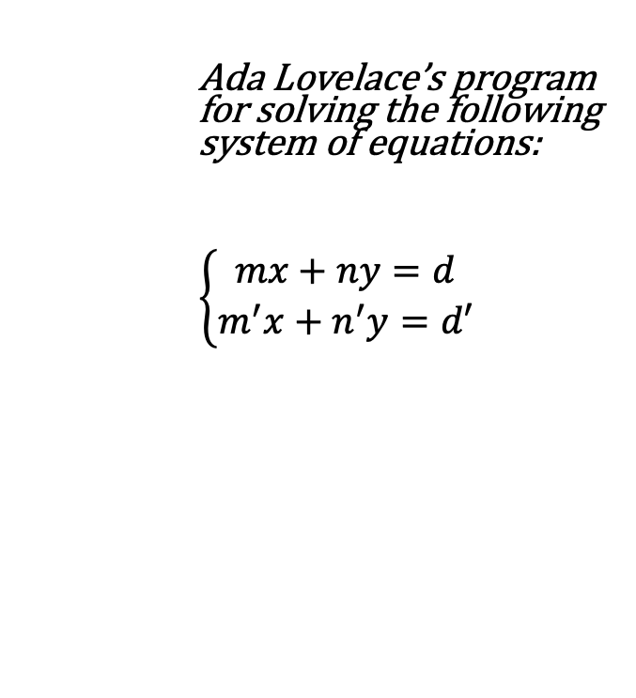
Babbage and Lovelace
Ada Lovelace’s program for solving the following system of equations:
$\left\{\begin{aligned}mx+ny=d \\ m^{′}x+n^{′}y=d′\end{aligned}\right.$

